Slide 1
CSUF 2018 Basketball Stats
By: Joshua Ungheanu, Cameron Mcphie, Andrew Shaker

Slide 2
Our web application…
Cal State University Basketball Statistic Web Application that contains data about each player, team and game.
Gives general viewers access to view the data only. To change any information on the website, users must log in.
Staff logged in – have access to view the data and make any changes;
Add
Edit
Delete
Only information on the database that the admin gives permission to modify.
MySQL admin has complete access to modifying the database and any information.

Slide 3
VIEWS
1. Use case
…
…
…
2. Deployment View
…
…
…
3. Implementation View
…
…
…
4. Requirement View
…
…
…

Slide 4
USE CASE QUESTIONS
What are the stats for last game?
Who played in game “X”?
What games did player “X” play in?
Who has an account?
…

Slide 5
USE CASE

Slide 6
ERD VIEW

Slide 7
DEPLOYMENT VIEW

Slide 8
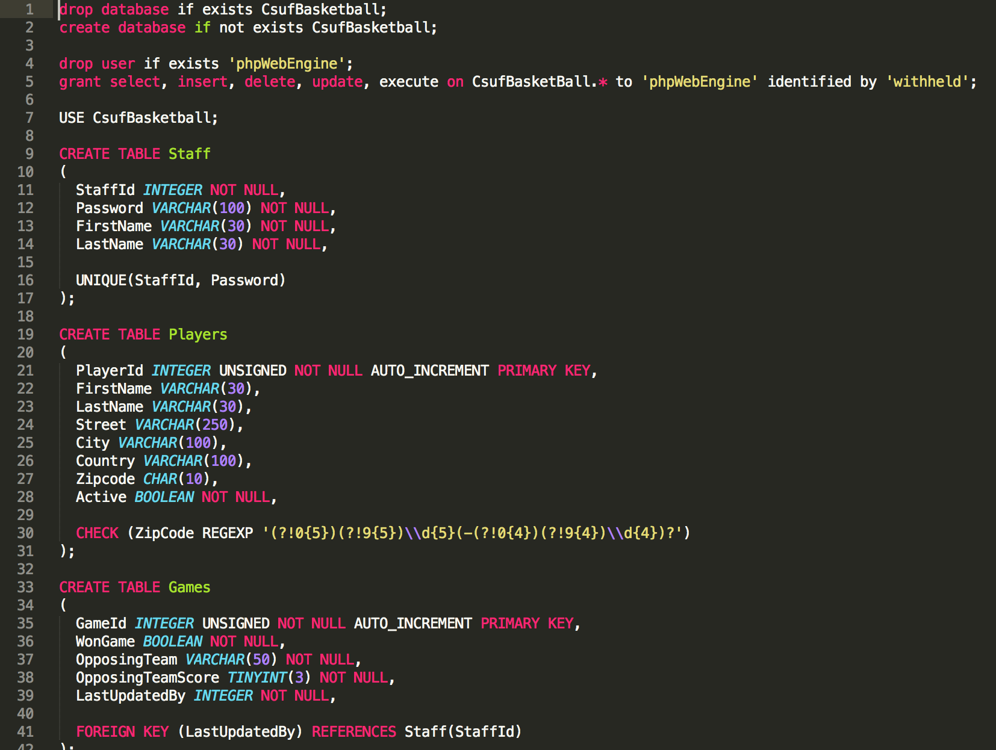
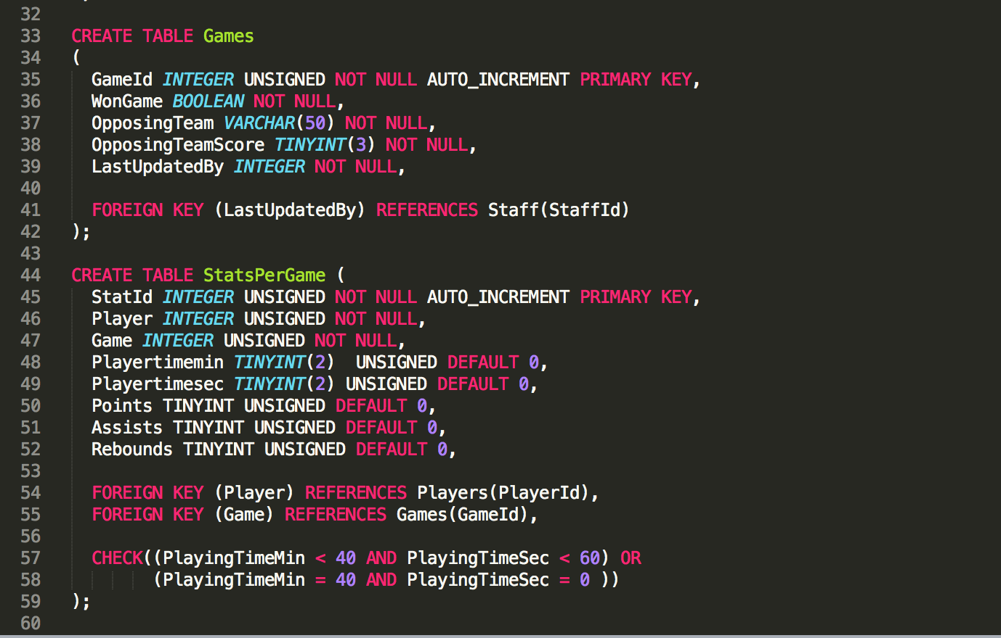
IMPLEMENTATION VIEW

Slide 9
REQUIREMENT VIEW
READERS:
Readers shall be able to view players statistic data.
Readers shall be able to view current games and upcoming games.
Readers shall be able to view each team and their statistics (games won, loss, and played).
Readers shall be able to view if players are active or inactive on certain games.
Readers shall not change any stats or crucial data for any player or game.
Readers shall not access any database or have control of any information.
ADMIN:
Admin shall be able to view players statistic data.
Admin shall be able to view current games and upcoming games.
Admin shall be able to view each team and their statistics.
Admin shall be able to view if players are active or inactive.
Admin shall be able to modify any data on the database.
Admin shall be able to remove any user off the database.
Admin shall be able to modify any tables in the database.
DATA:
Data shall be able to change as the users update the players.
Data shall be able to change as the admin changes the database.

Slide 10
CONFIGURATION MANAGEMENT VIEW
Configuration Management
Slack – Communication for when we are unable to meet and work together
Git & Github – Used to control documentation source and source code
Lucid Chart – Used for creating views
Atom – Text Editor used for writing code (Integrates with Github)
Apache – Web Server
MySQL – Relation Database Server
Linux(Ubuntu 16.04) – OS for running servers

Slide 11
The End
Thank you!

